Slide 1


TEAM HORUS
BUSINESS PLAN PRESENTATION
Nitte Meenakshi Institute Of Technology, Bengaluru

Slide 2
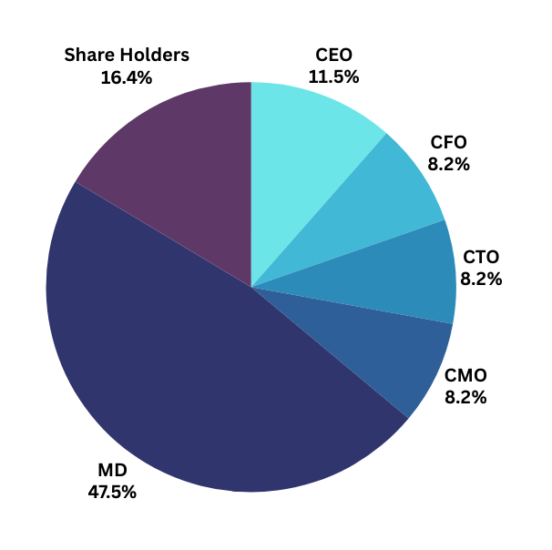
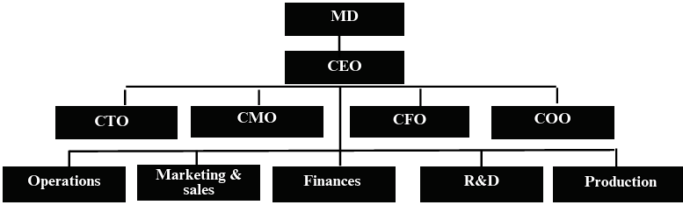
Company details
Ownership Details
Company Hierarchy
Production

Slide 3
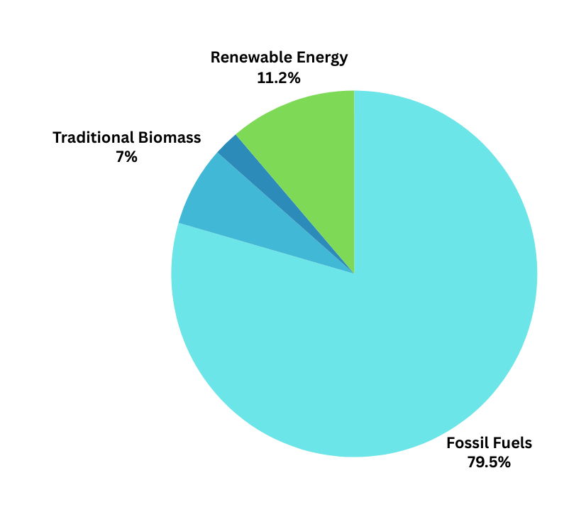
Problem Statement
Addressing the pressing challenge of escalating carbon emissions from conventional vehicles and the imminent depletion of fossil fuels, our business plan aims to spearhead the transition towards sustainable transportation solutions.

Slide 4


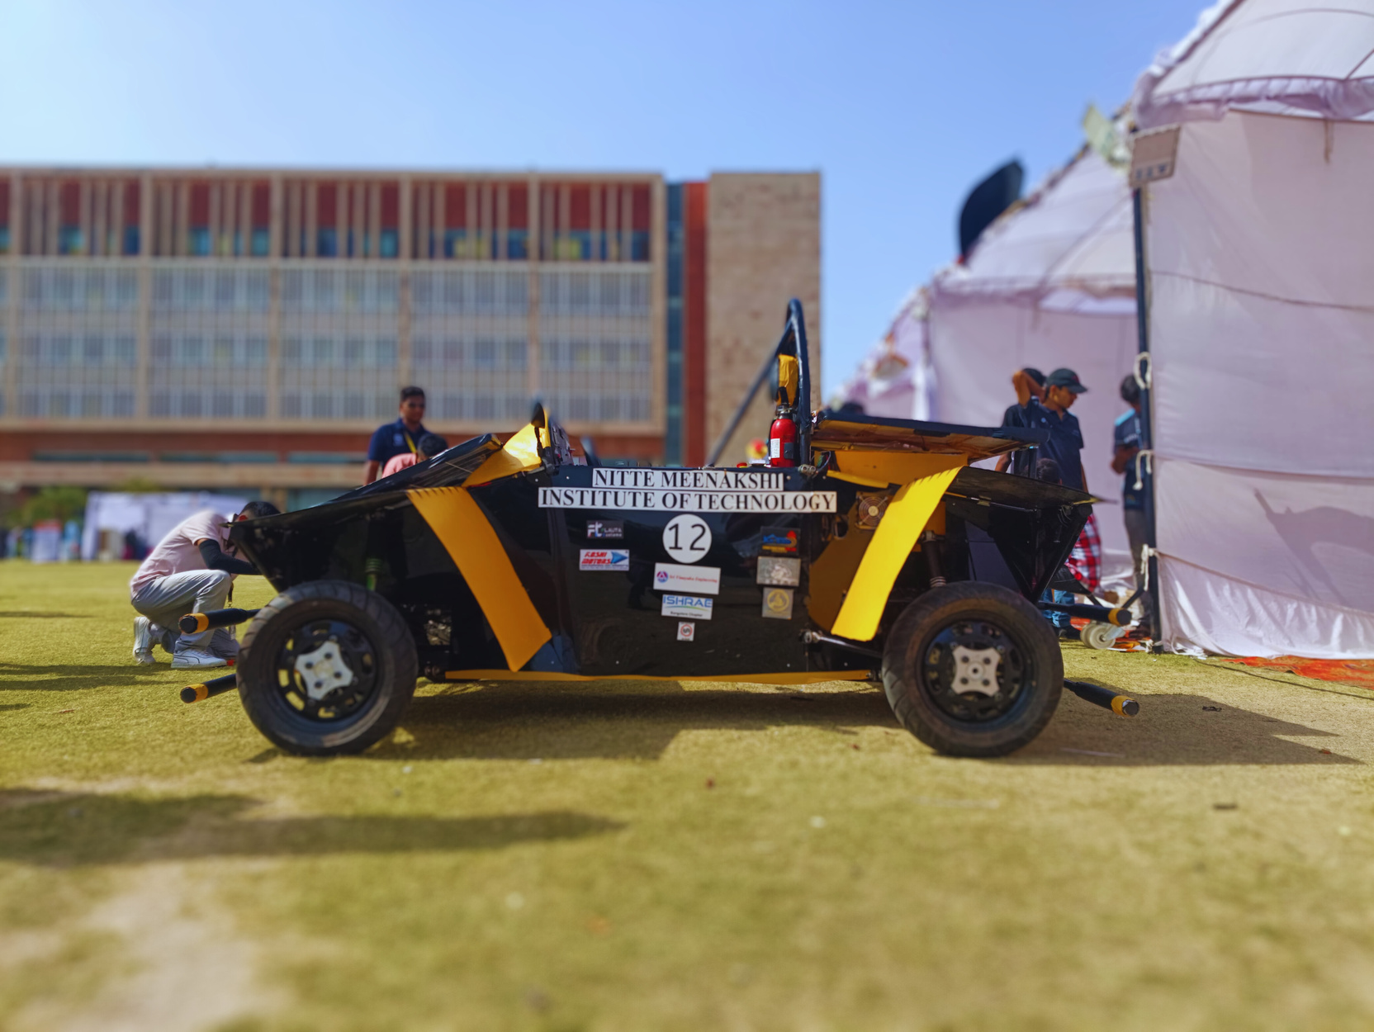





Product(Prototype)
Eco-Friendly
Body Works
Fault-Detection
System
Human-Machine Interface and
Natural Language Process
Power Inverter
System
Biometric Recognition
for Access
GPS Tracking

Slide 5
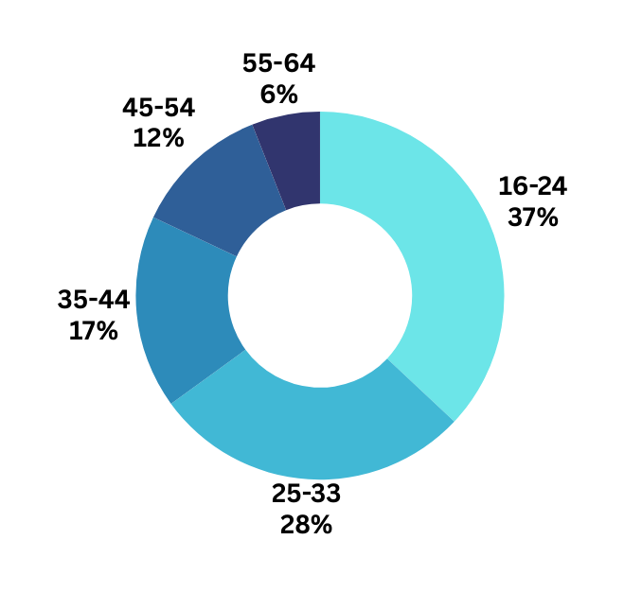
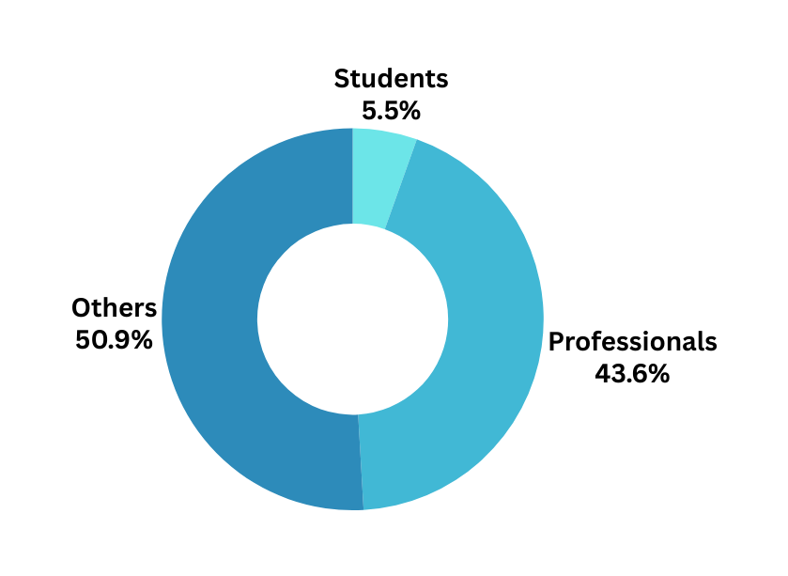

Market Analysis
Market size is estimated at USD 34.80 billion in 2024
And is expected to reach USD 110.74 billion by 2029
Growing at a CAGR of 26.05% from(2024-29)
Age Group
Segments

Slide 6
Our Business Model
Prototype Development and Testing (2024)
Other Companies | Team Horous
INR 13rs/km | INR 10rs/km
10 PM -6 AM price 1.5x | Fixed Price / 1.5x on Surges
Mostly depends on other car dealers | Economic as it is self produced
Commission = Fare per kilometer × Commission rate
= 10 INR/km × 0.25
= 2.75 INR/km
Launch of Rental Service (2025)
Break-Even Point (2027)
TCR = Fare per kilometer + Commission amount
= 10 INR/km + 2.75 INR/km
= 12.75 INR/km
Introduction of New Models (2028)
Expansion to Other Cities (2030)
Commission -Based model
15-25% commission levied on rides
Target Customers- Cabs and Rider-Sharers

Slide 7
Revenue Projections
Phase 1: Rental Phase (Year 1 to Year 2)
Total Annual Revenue = 25 cars × 6 trips/day × 365 days/year × INR 350/trip = INR 1,91,62,500
Phase 2: New Models Sales Phase (Year 3 onwards)
Four-Seater Model Sales: Total Annual Revenue = (Number of cars sold) × (Selling price per car) Total Annual Revenue = 100 cars × INR 8,00,000/car = INR 8,00,00,000
Two-Seater Model Sales: Total Annual Revenue = (Number of cars sold) × (Selling price per car) Total Annual Revenue = 100 cars × INR 7,00,000/car = INR 7,00,00,000
Battery Subscription Model (Year 1 onwards)
Subscription Revenue = (Number of cars) × (Average distance per day) × (Days per year) × (Rate per km) Subscription Revenue = 200 cars × 33 km/day × 365 days/year × INR 2/km = INR 48,18,000
Total revenue for one year (Phase 1): INR 1,91,62,500
Total revenue (Phase 2): 7,48,18,000

Slide 8
Financial Projections
OPEX :
Salaries: (25 drivers × INR 25,000/driver/month + 25 engineers × INR 40,000/engineer/month) × 12 = INR 1,95,00,000
Utilities: INR 25,000/month × 12 = INR 3,00,000
Insurance: 25 cars × INR 10,000/car/year = INR 2,50,000
Manufacturing Cost = Number of cars × Cost per car Manufacturing Cost = 25 cars × INR 8,00,000/car = INR 2,00,00,000
Variable Costs:
Maintenance: 25 cars × INR 2,000/car/year = INR 50,000
Fuel/Electricity: 25 cars × 33 km/day/car × 365 days/year × INR 0.57/km = INR 1,38,71,125
Unexpected Expenses (Contingency): INR 30,00,000
Total Cost = Fixed Costs + Variable Costs + Manufacturing Cost + Contingency Total Cost
= INR 1,95,00,000 (Salaries) + INR 3,00,000 (Utilities) + INR 2,50,000 (Insurance) + INR 50,000 (Maintenance) + INR 1,38,71,125 (Fuel/Electricity) + INR 2,00,00,000 (Manufacturing Cost) + 30,00,000 (10% of Total Cost (Contingency)) = INR 5,69,71,125
Total Expenses: INR 5,69,71,125

Slide 9


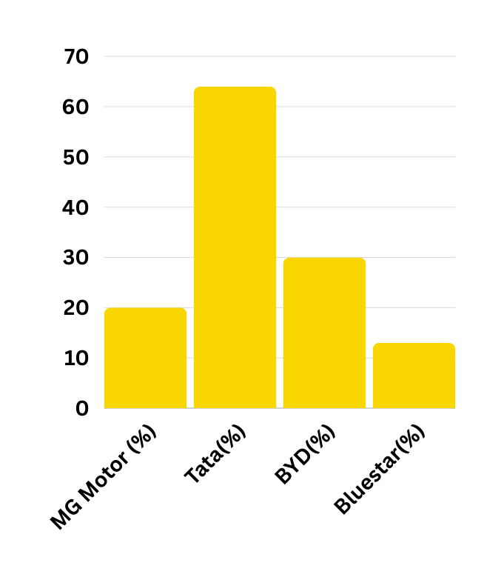


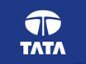


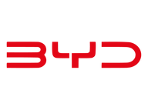



Competition Analysis
Contenders
Leaders
Evera
Uber
Tata
Ather
Go Green
BYD
Blustar
Ola
Niche
High Performers

Slide 10
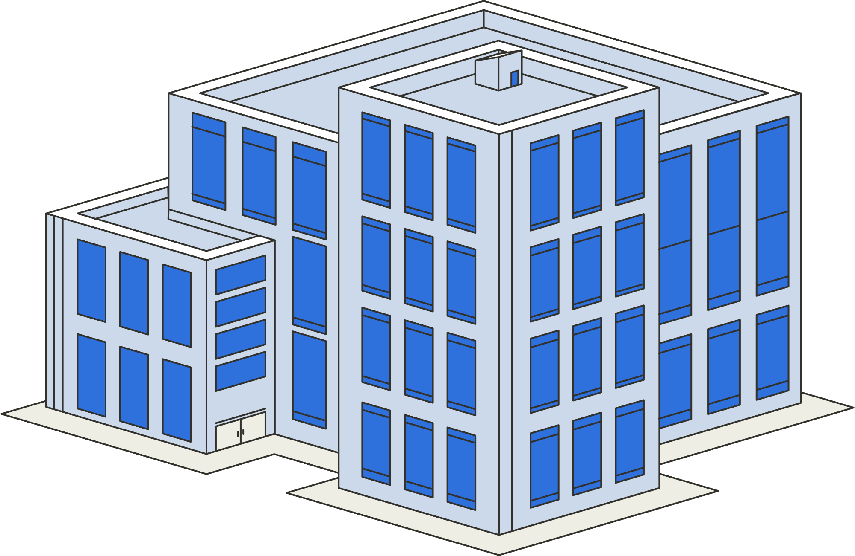
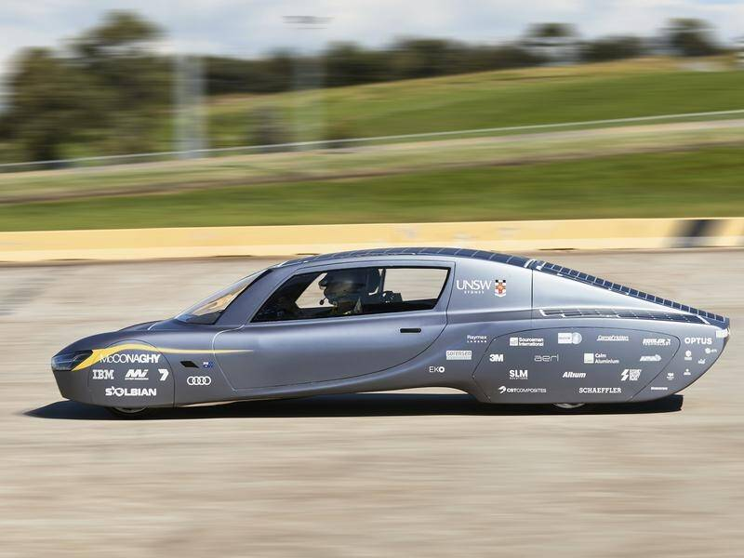
H.Q
Class S
The headquarters of Horus will be located in Mysore, Karnataka.
Larger connectivity network
Proximity to largest IT hub, Bengaluru
Skilled manpower
Class E

Slide 11
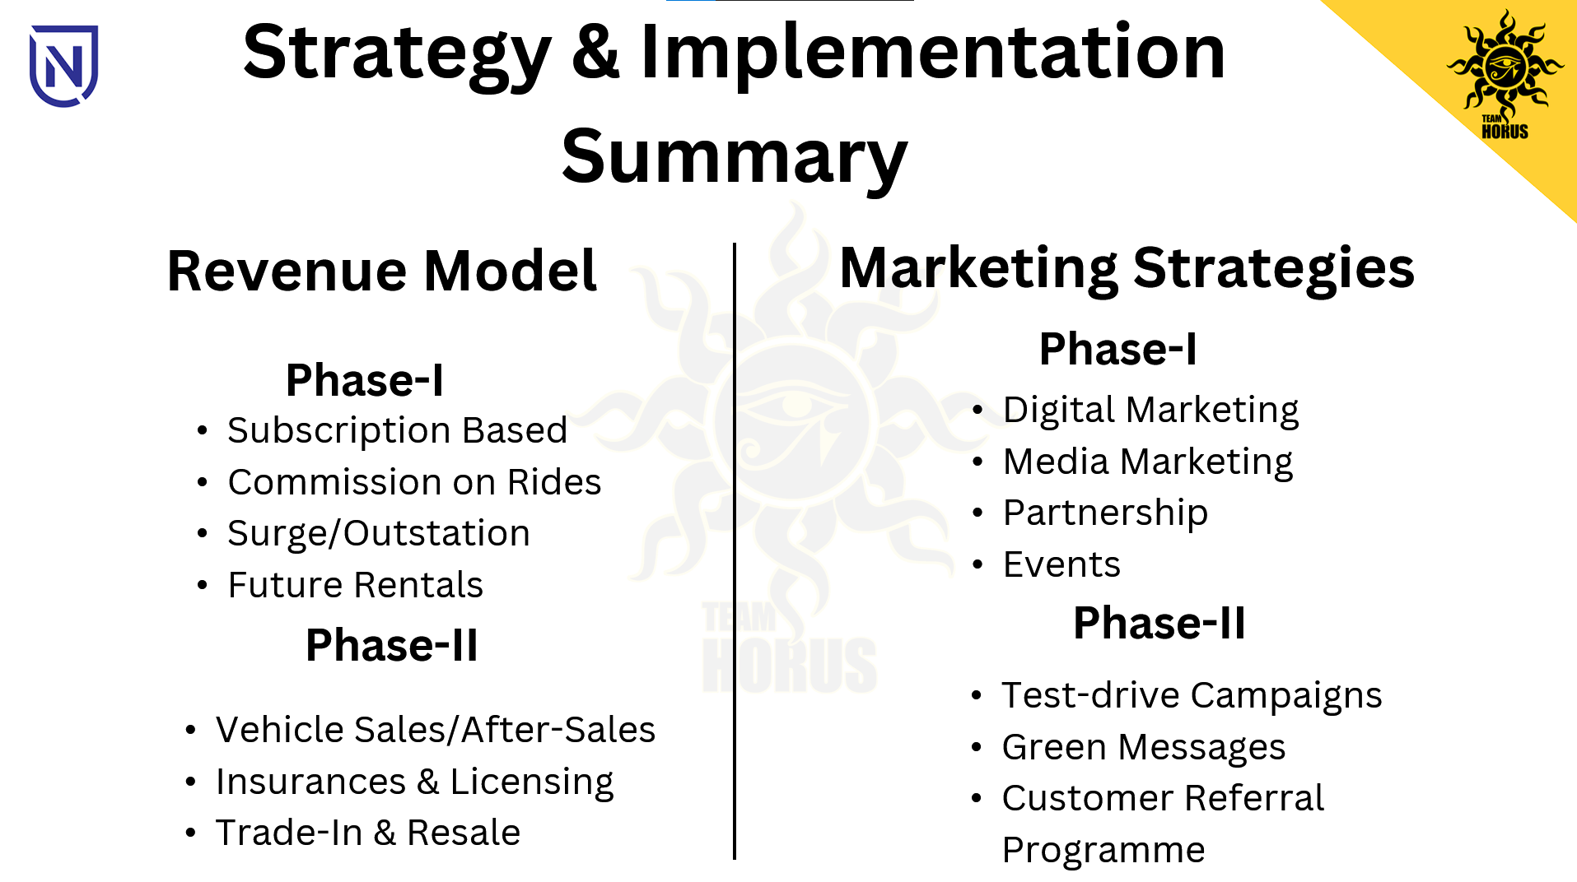

Slide 12
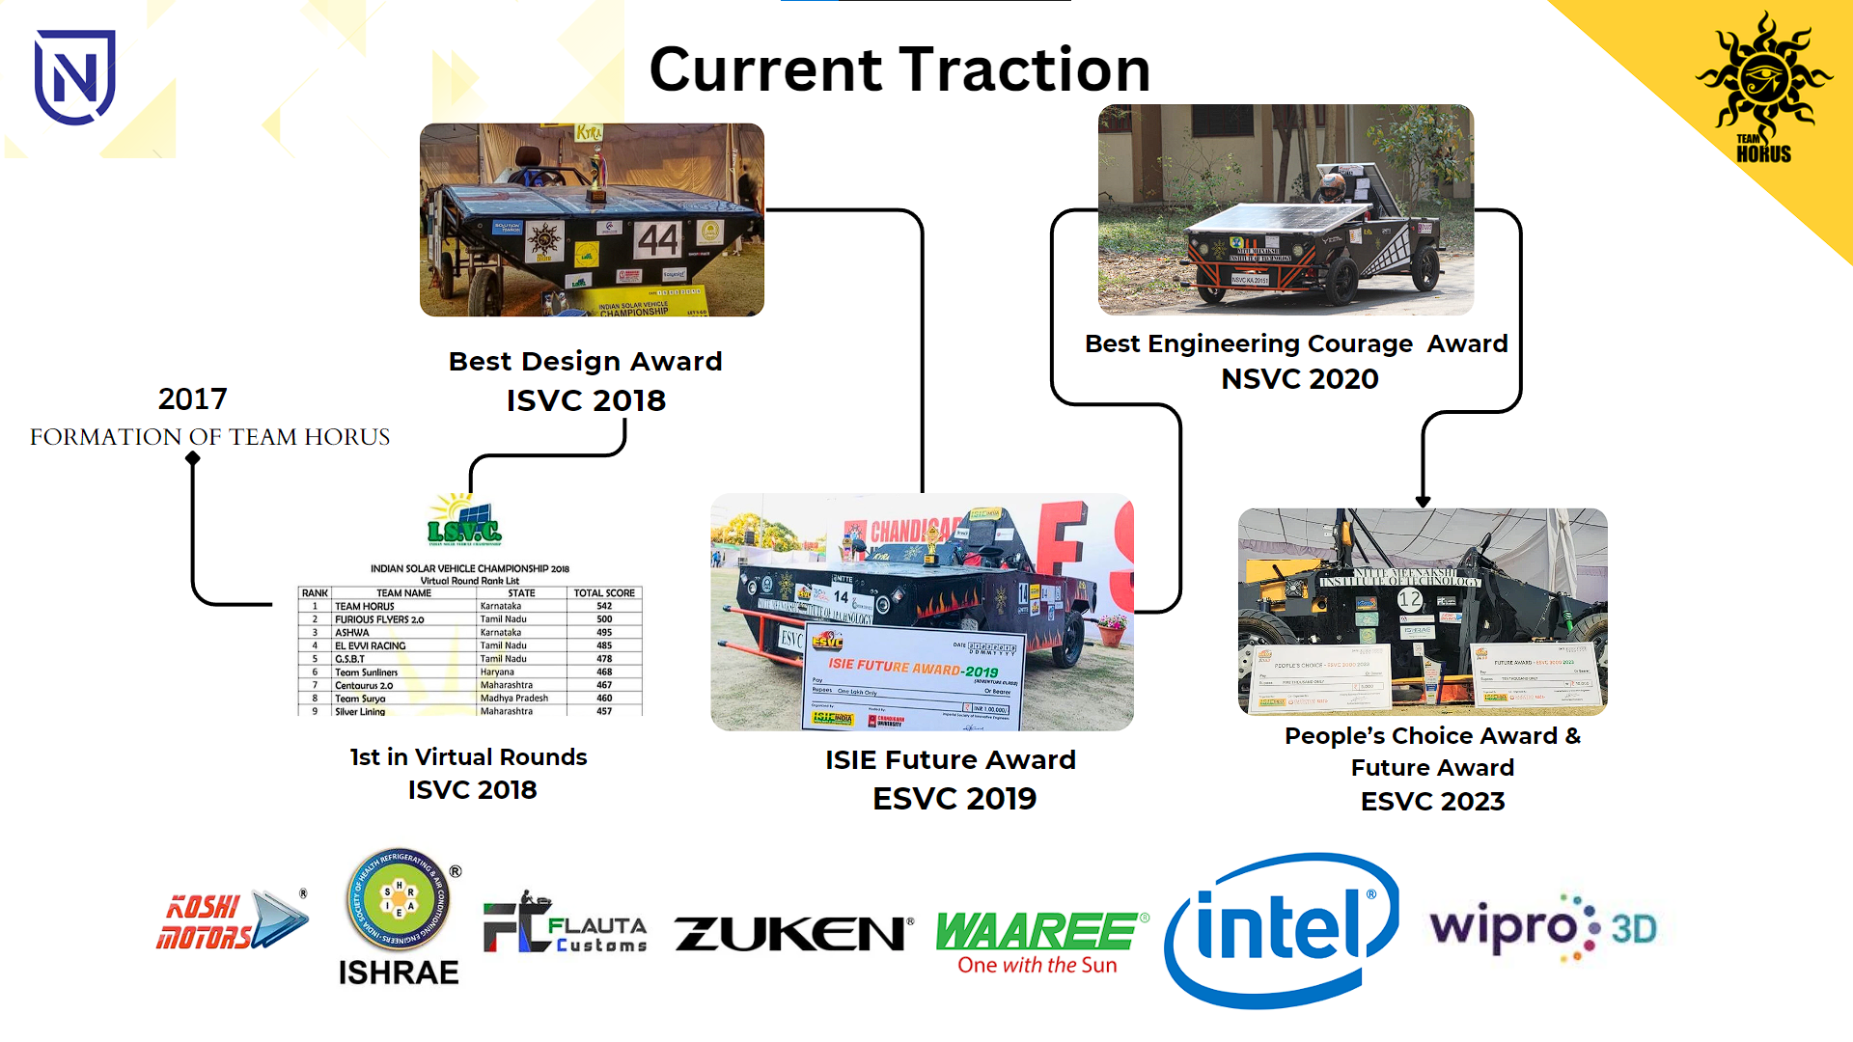

Slide 13
Return on Investment (ROI):
ROI=(Net Profit / Total Investment) * 100
ROI=(2,19,00,000 /6,00,00,000) * 100= 36.5%
Break-Even Point (In Years)=(Total Investment / Revenue) * 100
Break-Even Point (In Years)=(6,00,00,000 / 2,19,00,000) * 100= 2.7 Years
Exit Strategy:
Merger or Acquisition: Align with larger companies in the automotive or renewable energy sectors who might be interested in expanding their product offerings.
Initial Public Offering (IPO): Consider going public to raise substantial capital and provide a return on investment.
Management Buyout (MBO): The management team within the company acquires a large part or all of the company from the owner.
Liquidation: If the business is not successful, consider selling all of the company’s assets, paying off creditors, and returning any remaining assets to the owners.

Slide 14
Thank you!

